Slide 1
Where to use Statistics How to apply statistics
Vinay Mahajan
Varsha Mahajan
Types of study design
Reading and understanding of protocol
Understanding statistical terminologies and concepts

Slide 2
Understanding Clinical Study
Pre-read
Keywords for discussion :
Objective
Hypothesis
Design
Participants/Sample size
Interventions/Treatments
Outcome measures
Randomization
Double blind
Placebo control
Bias
Confounding
Exclusion criteria
Statistical methodology
Results/Conclusion

Slide 3
Study Goals: Objectives and Hypotheses
Define objectives of the study
State hypotheses
Specific statements about the effects of the treatment(s) being tested
Requires clinical and statistical input. Criteria for successful trial must be pre-defined based on scientific rational and must be convincing to a regulatory agency
Choose primary objective and hypothesis
Study can be designed well to answer one question
Primary question dictates the optimal design and sample size of the trial

Slide 4
Study Goals: Objectives and Hypotheses
Superiority
To show test drug is better than control
Most Phase II/III drug trials
Non-inferiority/equivalence
To show test drug is no worse than or similar to marketed drug
New drug has additional advantages compared to marketed drug (safety, cost, etc.)

Slide 5
Study Goals: Endpoints
Results, condition or events associated with individual study patients that are used to assess study treatments
Should be easy to diagnose, reliable and clinically relevant
Should have internal and external validity
Example: In Depression/Anxiety trial
“Result” of Interest: Functional improvement/ symptom relief
Hamilton Scale for Depression (HAM-D)
Hamilton Scale for Anxiety (HAM-A)
Global Impression of Change
Suicide rates (small numbers of events, efficacy and safety issue)

Slide 6
Study Goals: Primary Endpoints
Example: In oncology trials, endpoints are
Overall Survival (OS)
Progression Free Survival (PFS)
Time to Progression (TTP)
Objective response rate
The measure which can provide the best evidence directly related to the primary objective and hypothesis
A single primary endpoint should be identified to answer the primary question
Acceptable precision

Slide 7
Study Goals: Secondary Endpoints
Address other questions of interest
Show robustness of primary result
Help in interpretation of primary result
Clinically important endpoints with only a modest chance of detecting a positive result (e.g., mortality in a lipid reduction trial)

Slide 8
Study Goals: Example 1 (Superiority)
Objective: To evaluate the effect of treatment with alendronate 70 mg once weekly for 12 months as compared to the treatment with raloxifene 60 mg daily for 12 months on lumbar spine bone mineral density (BMD) in postmenopausal women with osteoporosis
Hypothesis: In postmenopausal women with osteoporosis, treatment with oral alendronate 70 mg once weekly will produce a mean increase from baseline in lumbar spine BMD at 12 months which is greater than that observed with oral raloxifene 60 mg daily.
Endpoint: BMD of the lumbar spine analyzed as percent change from baseline.

Slide 9
Study Goals: Example 2 (Equivalence)
Objective: To compare the efficacy of etoricoxib 60 mg daily to diclofenac sodium 150 mg daily in the treatment of osteoarthritis of the knee or hip during a 6-week treatment period as assessed by the WOMAC pain subscale
Hypothesis: Etoricoxib 60 mg daily will demonstrate comparable clinical efficacy to diclofenac sodium 150 mg daily in the treatment of osteoarthritis of the knee or hip as assessed by the WOMAC pain subscale. The equivalence range is ± 10 mm.
Endpoint: WOMAC pain subscale analyzed as average change from baseline, weighted over time

Slide 10
Study Planning
Potential issues with clinical trials
Bias
Confounding
Control bias and confounding
Concurrent controls
Randomization
Blinding
Study Designs
Type I and Type II errors
Sample Size and Power

Slide 11
Study Planning: Bias
Bias: Any procedure which tends to produce results or conclusions that differ systematically from truth
Caused by prejudice in the planning, conduct, analysis, or interpretation of clinical trials
(e.g., subject selection
allocation of subjects to treatments
measurement/evaluation of response
knowledge of measurements)

Slide 12
Study Planning: Bias
Example: Consider a single blinded trial of a cholesterol reducing drug
The endpoint is mean percent reduction in LDL cholesterol from baseline
Since the investigator knows the treatments of patients, he/she may judge those patients on active drug to have more drug-related side effects.
Intentionally or unintentionally, the investigator has introduced bias into the study.

Slide 13
Study Planning: Confounding
Definition: The effect of the treatment cannot be definitively distinguished from an effect that may have been caused by other factors.
Confounding is possible, if:
Factor has an effect on the outcome
AND
Distribution of patients over the treatment groups is not the same for each level of the factor ("stratum")

Slide 14
Study Planning: Confounding
Example: NIH funded stroke study comparing treatment A to treatment B in preventing stroke.
Outcome | Trt A | Trt B | Total
Favorable | 40 (40%) | 40 (40%) | 80
Not Favorable | 60 (60%) | 60 (60%) | 120
Total | 100 | 100 | 200

Slide 15
Study Planning: Confounding
Example (cont.)
NIH score ≤ 10
NIH score >10
Outcome | Trt A | Trt B | Total
Favorable | 25 (62.5%) | 15 (75%) | 40
Not Favorable | 15 (37.5%) | 5 (25%) | 20
Total | 40 | 20 | 60
Outcome | Trt A | Trt B | Total
Favorable | 15 (25%) | 25 (31.25%) | 40
Not Favorable | 45 (75%) | 55 (68.75%) | 100
Total | 60 | 80 | 140

Slide 16
Study Planning: Confounding
Example (cont.):
What appears to be no treatment effect is really an effect, but is lost by failing to stratify on NIH score.
Those receiving Trt B do better than those on Trt A within each NIH stroke group, but unequal A:B sample size ratio creates impression of no difference.

Slide 17
Study Planning: Controlling Bias and Confounding
Ways to control Bias and Confounding:
Concurrent controls
Blinding
Randomization

Slide 18
Study Planning: Concurrent Controls
Control group receives control treatment at about the same time as experimental treatment group
Prevents certain types of confounding (e.g., confounding due to time)
Sets a benchmark response or provides a comparator for the response in the experimental treatment group

Slide 19
Study Planning: Concurrent Controls
Placebo control
‘Gold standard’ for efficacy for a new indication
Easy interpretation, basis for drug registration
Active control (established treatment)
Placebo not ethically acceptable
Efficacy well established in placebo-controlled trials

Slide 20
Study Planning: Blinding
Blinding or masking is intended to limit the occurrence of conscious and unconscious bias in the conduct and interpretation of a clinical trial arising from the influence which the knowledge of treatment may have on:
Recruitment and allocation of subjects and their subsequent care
Attitudes of subjects to the treatments
Assessment of endpoints,
Handling of withdrawals, the exclusion of data from analysis, etc.
The essential aim is to prevent identification of the treatments until all such opportunities for bias have passed.

Slide 21
Study Planning: Blinding
Single Blinding
The subject does not know which treatment he/she was given. The investigator knows.
Possible bias in data collection and assessment.
Double Blinding
The investigator and subject do not know which treatment the subject was given
This level of blinding is maintained throughout the conduct of the trial
When the data are cleaned to an acceptable level of quality, will appropriate personnel be unblinded
Sometimes bioanalytical scientist, auditors or personnel handling SAE reporting may need to unblind subject
The sponsor should have SOP to guard against inappropriate dissemination of treatment codes.

Slide 22
Study Planning: Blinding
Difficulties in achieving the double-blind ideal can arise:
Treatment may be of a completely different nature, e.g., surgery and drug therapy
Two drugs may have different formulations – partial solution to this “Double Dummy” technique
Double-blind nature may be partially compromised by apparent treatment induced effect. For example, immunosuppressive drug may reduce the lymphocyte counts dramatically
If a double-blind trial is not feasible, then the single-blind option should be considered
In some cases only an open-label trial is practically or ethically possible.

Slide 23
Study Planning: Randomization
Randomization introduces a deliberate element of chance into treatment allocation
Purpose: to balance groups on both observed and unobserved factors
Measured and unknown prognostic factors will balance out among the treatment groups
Any observed effect in the response can be attributed to the treatment because the only systematic difference in the groups is the treatment
In multicenter trials, a separate random scheme for each center should be available, i.e. to stratify by center or to allocate several whole blocks to each center.

Slide 24
Study Planning: Randomization
Stratification by important prognostic factors measured at baseline (e.g. severity of disease, age, sex, etc.) may sometimes be valuable to promote balanced allocation within strata
The use of more than two or three stratification factors is rarely necessary, is less successful at achieving balance and is logistically troublesome
A dynamic allocation procedure may help to achieve balance across a number of stratification factors
Factors on which randomization has been stratified should be accounted for later in the analysis.

Slide 25
Study Planning: Study Designs
Select a study design which will allow us to draw valid statistical conclusions from the data (i.e., avoids bias and confounding)
Two common study designs are
Parallel
Crossover

Slide 26
Study Planning: Parallel Group Designs
Experimental Treatment
Assess Endpoints
Participants screened for entry criteria
Control Treatment
Assess Endpoints
Screening
Baseline
Treatment
Time

Slide 27
Study Planning: Crossover Designs
Experimental Treatment
Assess Endpoint
Experimental Treatment
Assess Endpoint
Participants screened for entry criteria
Control Treatment
Assess Endpoint
Control Treatment
Assess Endpoint
Screening
B/L
Treatment (Period 1)
{Washout}
Treatment (Period 2)

Slide 28
Study Planning: Crossover Designs
Each subject is randomized to a sequence of treatments with a wash-out period between treatments
Each subject serves as his/her own control
Eliminates between-subject variation

Slide 29
Study Planning: Crossover Designs
Needs smaller sample size than parallel designs
Wash-out period needs to be long enough so that there is no carryover effect
Not appropriate when
Treatment period is long
Treatment intended to be curative
Washout period is long (drugs with long half-life)
Carryover exists

Slide 30
Study Planning: Designs
 | Parallel Design | Crossover Design
Length | Shorter | Longer
Sample Size | Larger | Smaller
Precision of Estimates | Less | More
Endpoints/ Diseases | Most | Some

Slide 31
Study Planning: Statistics Input
Statistical testing
Type I & II errors
Power
Sample Size

Slide 32
Study Planning: Statistical Testing
We don’t know the truth about the experimental drug if it is effective or not
So we conduct a placebo control clinical trial and perform a statistical test using the data from the trial to make a decision
We set two hypotheses, null and alternative
Null Hypothesis H₀: No difference between experimental drug and Placebo
Alternative Hypothesis H_{A}: The experimental drug is better than Placebo
Strategy is to assume H₀ (e.g., drug not effective) is true until “proven” otherwise

Slide 33
Study Planning: Statistical Testing
Decision
Reject the hypothesis of no treatment difference if the chance of obtaining trial data has a small probability, assuming there’s no treatment difference
We could make 2 types of errors with the decision:
Type I error (false positive)
Type II error (false negative)

Slide 34
Study Planning: Type I Error
Type I error
α = probability of Type I error (false positive)
= probability of concluding that the drug works but the truth is that drug doesn’t work

Slide 35
Study Planning: Type II Error and Power
Type II error
β = probability of Type II error (false negative)
= probability of concluding that the experimental drug doesn’t work, but the truth is experimental drug works
Power (= 1- β )
= probability of correctly concluding that the drug works

Slide 36
Study Planning: Type I & II Errors
Truth
Drug Drug not
effective effective
Trial Positive
Results
Negative
Correct | Type I error
Type II error | Correct

Slide 37
Study Planning: Type I and Type II Errors
If you reduce the probability of one error, the other one increases.
β
α

Slide 38
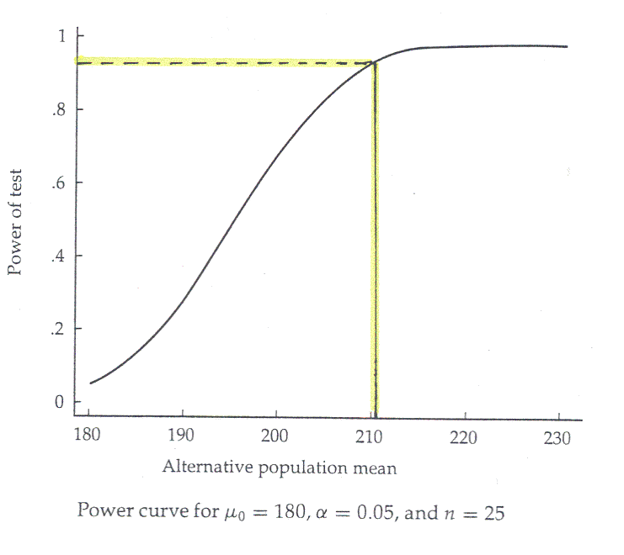
Study Planning: Power
Power is a function of the drug effect (how much the drug is better than placebo)
Larger differences are easier to detect

Slide 39
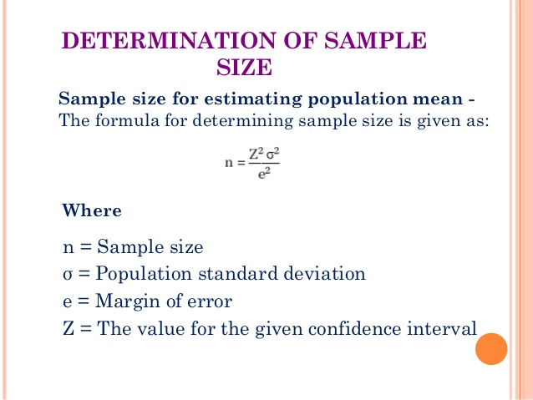
A generic formula for sample size
https://www.google.com/url?sa=i&url=https%3A%2F%2Fwww.slideshare.net%2FSanchitAggarwal6%2Fbrm-sampling-techniques&psig=AOvVaw26puTZEfemoB9hBe7S3fKg&ust=1595661178598000&source=images&cd=vfe&ved=0CAIQjRxqFwoTCMDdjqmr5eoCFQAAAAAdAAAAABAD

Slide 40
Study Planning: Sample Size
Factors influencing sample size
Power (1- β)
Type I error probability (α)
Variability
Clinically meaningful difference we wish (need) to detect or detectable difference

Slide 41
Study Planning: Sample Size
Power (1- β)
As power ↑, sample size ↑
Type I error probability (α) (usually fixed at 0.05)
As α-level ↓, sample size ↑
Variability
As variability ↑, sample size ↑
Detectable difference
As difference ↑, sample size ↓

Slide 42
Study Planning: Sample Size
A
B
A
B
Question: Which requires the larger sample size
to show that A and B are different ? (similar δ )

Slide 43
Study Planning: Sample Size
A
B
A
B
Question: Which requires the larger sample size
to show that A and B are different ? (similar σ )

Slide 44
Study Planning: Sample Size
A sponsor would always like to detect a clinically meaningful difference, if it exists. That means, the power has to be close to 100%
However, for a power close to 100%, we need to enroll a LARGE number of patients.
So a compromise has to be made depending on study goals:
80% in Phase I/IIa studies
90-95% in Phase IIb/III studies

Slide 45
Study Planning: Sample Size
On the other hand, regulatory agencies would always like to minimize the type I error, ideally as close to zero. But, to do that, we need to enroll a LARGE number of patients!
So, again, a compromise has to be made. Usually, the type I error rate is set as 0.05.

Slide 46
Statistical Analysis Methods
Two methods:
Estimation
Hypothesis testing

Slide 47
Statistical Analysis Methods: Estimation
Point estimation
A single value that is the best guess of true parameter based on sample
Example: Sample mean is a point estimate of the population mean
Interval estimation
Confidence interval (CI)
Interval surrounding the point estimate
Provides more information than a point estimate

Slide 48
Statistical Analysis Methods: Estimation
Example:
100 95% CIs for the difference in 2 means when the true difference is 0 (N=50)

Slide 49
Statistical Analysis Methods: Estimation
95% CI:
Definition: If we repeat a study 100 times and compute a 95% CI based on each study, expect on average, 95 out of 100 of the intervals would include the true mean.
95% confident that the interval includes the true mean

Slide 50
Statistical Analysis Methods: Estimation
Confidence level ↑, width of CI ↑
(ex. 95% CI is longer than 90% CI)
Sample size ↑, width of CI ↓
Standard deviation ↑, width of CI ↑
http://mathwithmayer.weebly.com/uploads/3/7/2/7/37277397/stats_6.2_powerpoint.pdf

Slide 51

Statistical Analysis Methods: Hypothesis Testing
Coin Tossing Experiment
p = Probability{Head}
1- p = Probability{Tail}
Hypothesis: The coin is unbiased, i.e., p = 0.5
Conduct following experiment to test hypothesis
Now I toss the coin, and the “Head” appears
Given that the coin is unbiased, what is the chance that we observe Head? 0.5

Slide 52
Statistical Analysis Methods: Hypothesis Testing
Now I toss the coin twice, and the outcome is
{H, H}
Given that the coin is unbiased, what is the chance that both trials result in “Head”? 0.5 x 0.5 = 0.25
Now I toss the coin ten times, and each time I observe “Head”
Given that the coin is unbiased, what is the chance that all the trials result in “Head”?
0.5 x 0.5 x …. x 0.5 (10 times) = 0.00098
Result highly unlikely, so conclude coin is biased

Slide 53
Statistical Analysis Methods: Hypothesis Testing
P-Value:
Probability of observing the study outcome or something more extreme if H₀ is true
Probability that the study outcome is due to chance
Measure of evidence against H₀
(lower p-value, higher evidence against H₀)

Slide 54
Statistical Analysis Methods: Hypothesis Testing
P-Value:
Criteria for success based on pre-specified α, the maximum chance we are willing to take to make a false positive
If p-value < α
Reject H₀
Positive (significant) outcome

Slide 55
Online calculator example
https://www.socscistatistics.com/tests/binomial/default2.aspx

Slide 56
Statistical Analysis Methods: Hypothesis Testing
Assume the
population
mean age is 50
( )
Identify the Population
Take a Sample
If not likely, then
REJECT
Null Hypothesis

Slide 57
Example: Blood Pressure Measurements
Doctor’s advice: Take medication if SBP>140 mmHg
So we take BP readings 3 times per day for 2 weeks. Let readings be random sample from population with mean μ. The mean SBP is 150 mmHg
Test hypotheses H₀: μ≤140 vs. H₁: μ >140
Establish support for H₁ by showing evidence against H₀ in favor of H₁

Slide 58
Example (Cont.)
Sampling Distribution of SBP under H₀
H₀: μ ≤ 140
H₁: μ > 140
P-Value: The probability that mean SBP is 150 mmHg or higher, if in fact the population mean is 140 mmHg
Use the alternative hypothesis to find the direction of the rejection region.
140
150
P-Value = Pr ( ≥ 150)
If P-value is < 0.05, then reject H₀ at 5% level.

Slide 59


Slide 60
Assignment
From the pre-read, identify the concepts which have been discussed in the last two classes and summarize them in a word document.
Save these with the following name “Day_3&4_assignment1_yourname.doc”

Slide 61
Assignment
Observe the data in the attached excel and classify the variables as qualitative or quantitative
Create the summary statistics i.e. summarize for each of the variables based on their nature
Save these with the following name “Day_3&4_assignment2_yourname.doc”

